Slide 1
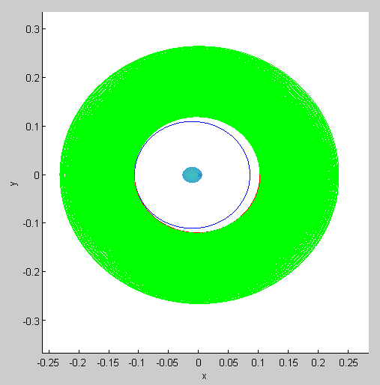
Initial Orbit: GEO
Ra = Rp = 0.110
Thrusts:
ΔV₁ = 120 m/s
ΔV₂ = 7.6 m/s
Conditions at sail deployment:
Rp= 36,200 km altitude
Ra = 43,000 km altitude
Trajectory after sailing:
t = 1 year
t = 2 years
t = 3 years

Slide 2
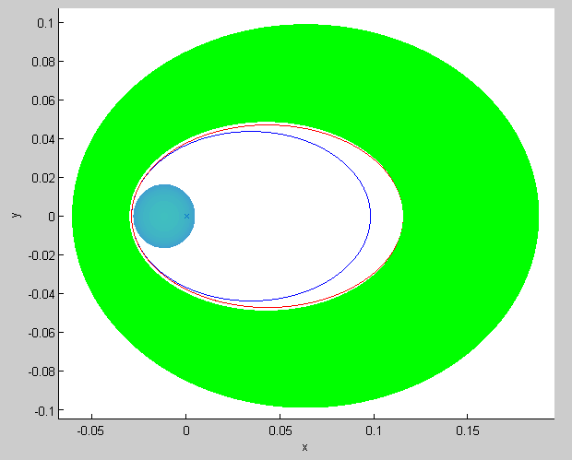
Initial Orbit: GTO
Rp = 0.017 (278 km alt.)
Ra = 0.110 (35,764 km alt.)
Thrusts:
ΔV₁ = 53 m/s
ΔV₂ = 100 m/s
Conditions at sail deployment:
Rp= 800 km altitude
Ra = 42,560 km altitude
or
Trajectory after sailing:
ΔV₁ = 97.7 m/s
ΔV₂ = 47 m/s
t = 1 year
t = 2 years
t = 3 years

Slide 3
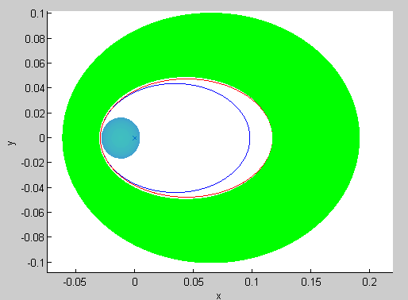
Initial Orbit: GTO
Rp = 0.017 (278 km alt.)
Ra = 0.110 (35,764 km alt.)
Thrusts:
ΔV₁ = 106 m/s
ΔV₂ = 47 m/s
Conditions at sail deployment:
Rp= 800 km altitude
Ra = 43,227 km altitude
Trajectory after sailing:
t = 3 years

